Slide 1

Practice #2: Feed Forward Neural Network Simple Multi-layer Perceptron
[SKT AI Course: Deep Learning Basics]
TA: Jun-Sik Choi & Jee-Seok Yoon
Instructor: Heung-Il Suk
hisuk@korea.ac.kr
http://www.ku-milab.org
Department of Brain and Cognitive Engineering,
Korea University
September 23, 2017

Slide 2
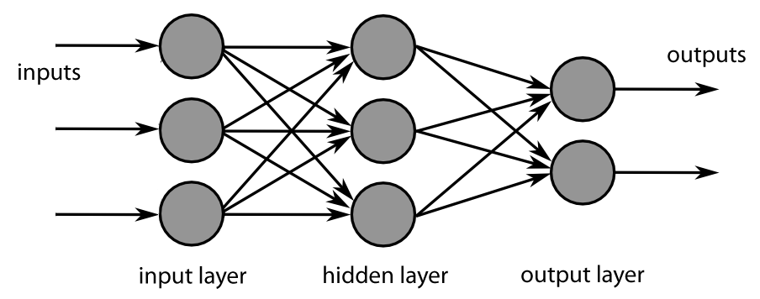
Feed Forward Neural Network
Neural Network → Multi-layer Perceptrons!
Vector calculation to matrix calculation
Notes:
Vector → Matrix! That’s it!

Slide 3
Class NeuralNetwork
Class Variables
num_units : Determine overall model structure
eta : learning rate
epochs : number of training epochs
weight_initialized : Is model weight initialized?
bShuffle : Shuffle dataset or not
minibatch_size : size of mini_batch
activation_function : activation function to use
verbose : print log or not
weights : List storing weight of each layers
gradient : List storing gradient of each layers
delta : List storing delta values for backpropagation
net_value : List storing Weight * neuron (Phi function)
activation_value : List storing activation values
training_cost : List storing mini-batch average loss during training
training_error : List storing mini-batch average error during training
validation_error : List storing mini-batch average loss during validation

Slide 4
Class NeuralNetwork
Major Class Methods
buffer_clear : Clear stored variables
initialize_weights : Initialize parameters after buffer clearing
compute_loss : Compute activation and loss value at the last layer.
activation : Compute activation values of each layer.
forward : propagate activation value through {input - hidden … hidden – output}
get_predicted_label : Return model prediction
train : train model for num_epochs.
compute_gradient : compute gradient for backpropagation
update_weights : update model weights using update rule.

Slide 5
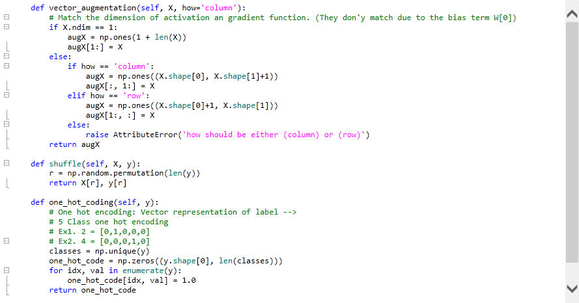
Detailed Implementation Overview
Notes:
Vector → Matrix! That’s it!

Slide 6
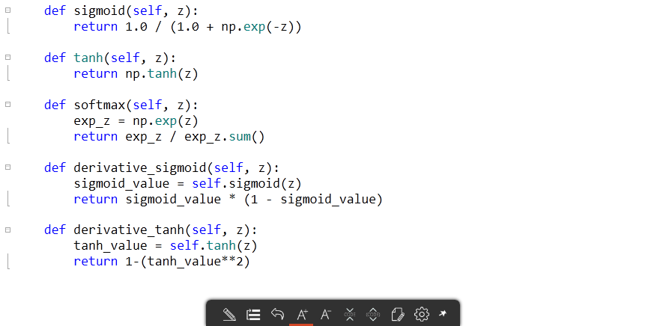
Detailed Implementation Overview
Notes:
Vector → Matrix! That’s it!

Slide 7
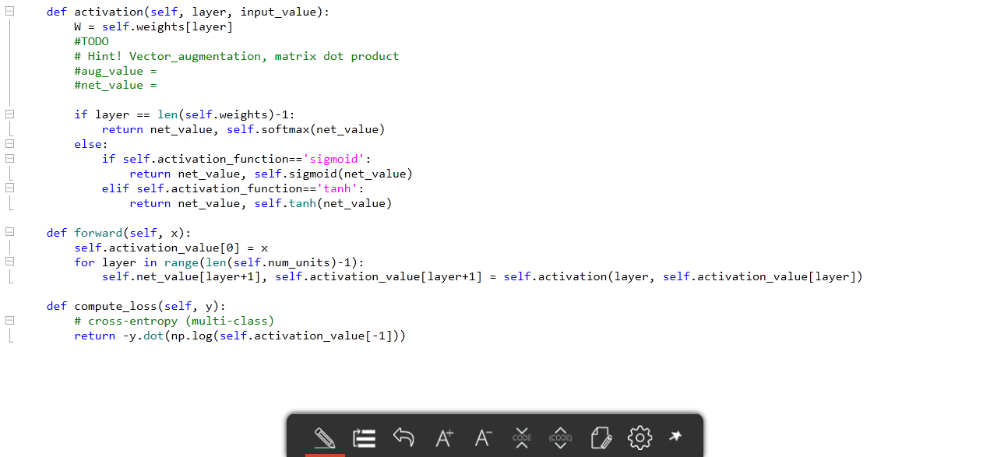
Detailed Implementation Overview
Notes:
25쪽!

Slide 8
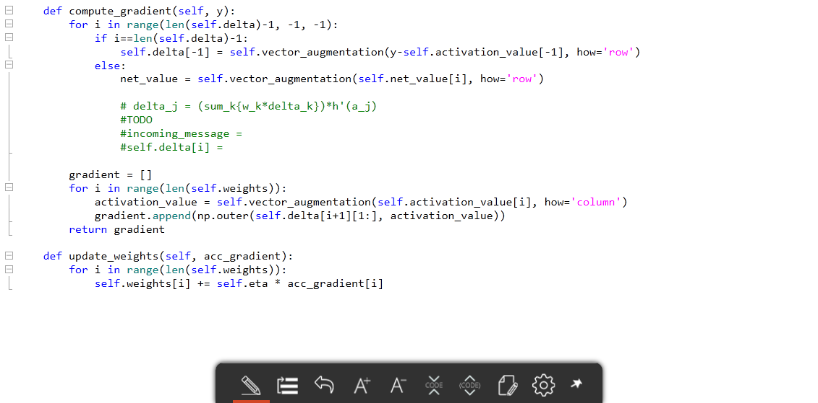
Detailed Implementation Overview
Notes:
38장 참고

Slide 9
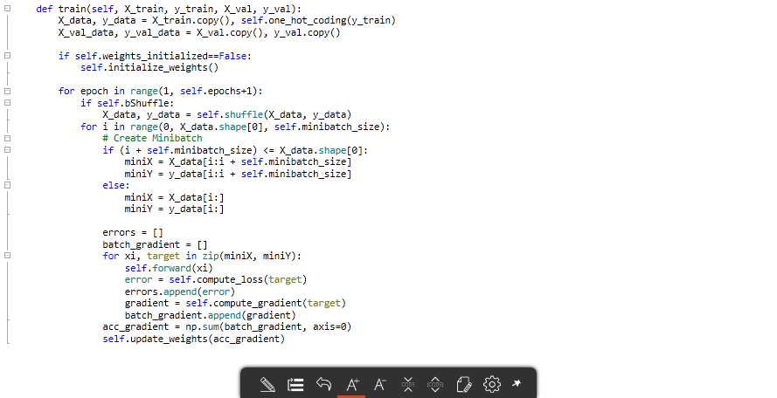
Detailed Implementation Overview
Notes:
Vector → Matrix! That’s it!

Slide 10
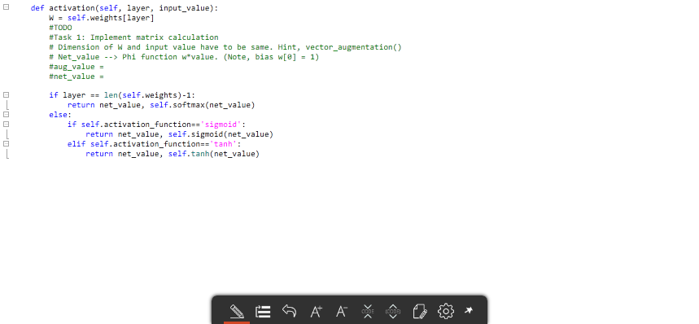

Implement major methods of Class FF (1)
Task 1: Implement matrix calculation in method activation(layer, input_value)

Slide 11
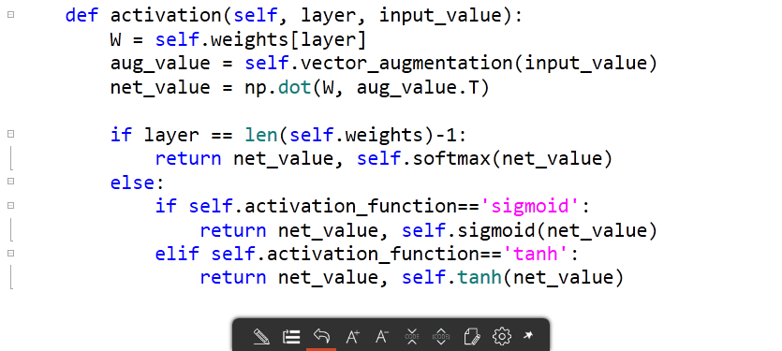
Answer
Task 1: Implement matrix calculation in method activation(layer, input_value)

Slide 12
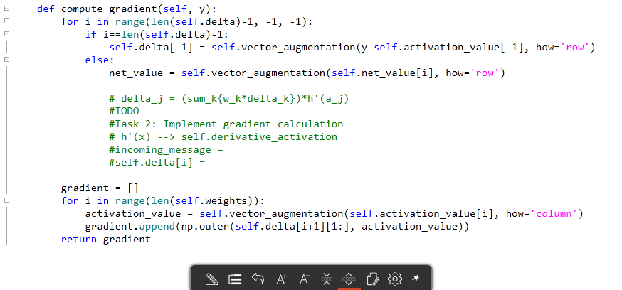
Implement major methods of Class FF (2)
Task 2: Implement gradient calculation in method compute_gradient(y)

Slide 13
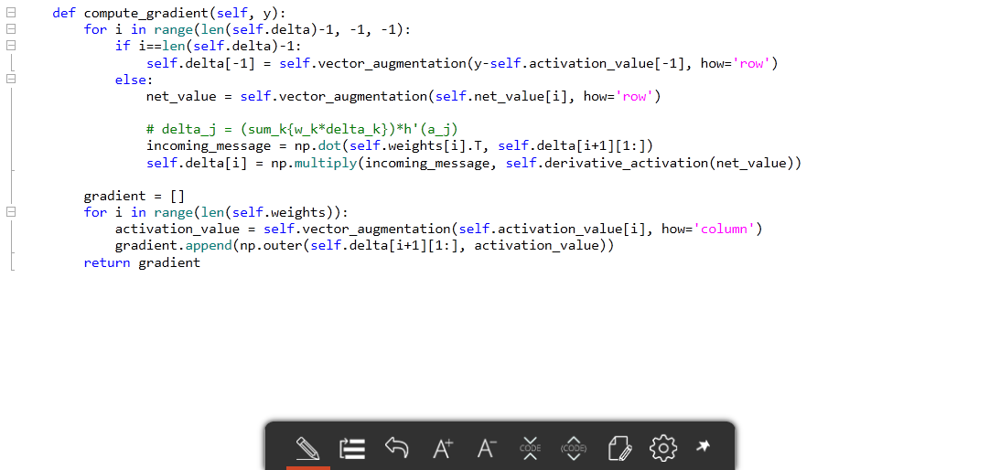
Answer
Task 2: Implement gradient calculation in method compute_gradient(y)

Slide 14
Thank you
for your attention!!!
(Q & A)
hisuk (AT) korea.ac.kr
http://www.ku-milab.org

